Slide 1

Smart Pet Collar Business Evaluation for the European Market
AI-Generated Presentation • Confidential

Slide 2
Executive Summary
1
2
3
4
5
Market size
Growth rate
Product concept
Target market
Key benefit
European pet wearable market valued at €751.3 million in 2023
Projected to grow at a CAGR of 14.6% through 2030
Combines hardware and software subscription model
Premium segment of European pet owners
Provides GPS tracking, camera feed, and health monitoring
2

Slide 3

Product features
1
GPS tracking, camera feed, and health monitoring
Product Concept Analysis
Target species
2
Cats and dogs
Key benefit
3
Provides peace of mind for pet owners
Technical requirements
4
Integration of GPS, camera, and health sensors
Market demand
5
High demand for premium pet care products
3

Slide 4
European Market Analysis
MARKET SIZE
GROWTH RATE
PET OWNERSHIP RATE
PREMIUM SEGMENT
€751.3 million
14.6%
35%
25%
European pet wearable market in 2023
Projected CAGR through 2030
Of European households own a pet
Of pet owners willing to pay for premium products
4

Slide 5
European Competitive Landscape
ESTABLISHED PLAYERS
NEW ENTRANTS
Established players: Well-known brands with existing market share
Pricing strategy: Premium pricing for high-end products
New entrants: Startups and new companies entering the market
Market share: 20%: Of the market held by the top three players
Key differentiators: Unique features and benefits of each product
Growth opportunities: 15%: Of the market available for new entrants
5

Slide 6
European Pet Wearable Market Size and Projections
YEAR
MARKET SIZE (€ MILLION)
ANNUAL GROWTH RATE (%)
TECHNOLOGY SEGMENT LEADER
2023
751.3
-
RFID
2024
860.9
14.6
RFID
2025
986.6
14.6
GPS
2026
1,130.6
14.6
GPS
2027
1,295.7
14.6
GPS
2028
1,484.9
14.6
GPS
2029
1,701.7
14.6
GPS
2030
1,950.8
14.6
GPS
6

Slide 7
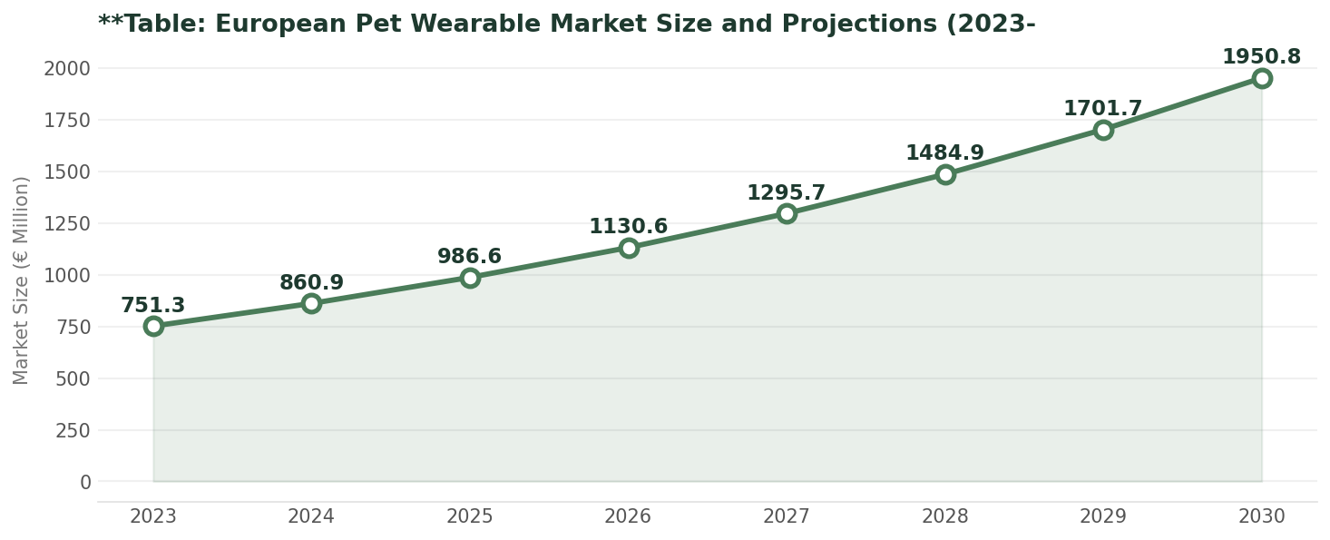
European Pet Wearable Market Size and Projections
Data visualization from document analysis
📊
7

Slide 8

Technical requirements
1
Integration of GPS, camera, and health sensors
Technical Feasibility and Financial Analysis
Development costs
2
€500,000: Estimated initial development costs
Production costs
3
€50: Estimated per unit production costs
Revenue projections
4
€10 million: Projected revenue in the first year
Growth rate
5
20%: Projected annual growth rate
8

Slide 9
Go-to-Market Strategy
01
02
03
04
05
Market research
Product launch
Marketing campaign
Sales strategy
Customer support
Identify target audience and market trends
Launch product in key European markets
Execute marketing campaign to raise awareness
Establish sales channels and partnerships
Provide excellent customer support and service
9

Slide 10

Key Opportunity
The European pet wearable market presents a significant opportunity
Growing demand: For premium pet care products
Increasing adoption: Of pet wearables and related technology
Competitive advantage: For companies that can provide unique features and benefits
10

Slide 11

Strengths
1
Unique features and benefits of the product
SWOT Analysis and Risk Assessment
Weaknesses
2
High development and production costs
Opportunities
3
Growing demand for premium pet care products
Threats
4
Competition from established players and new entrants
Risk mitigation
5
Strategies to mitigate risks and ensure success
11

Slide 12

Conclusions and Recommendations
→
The European pet wearable market presents a significant opportunity
→
Unique features and benefits: Provide a competitive advantage
→
Growing demand: For premium pet care products
→
Strategic partnerships: Can help drive growth and adoption
→
Key recommendation: Invest in the development and launch of the product
12

